Slide 1

EXCEL MODULE 6 – DATA TABLES
ENHANCING YOUR DATA ANALYSIS SKILLS PATHWAY
2023

Slide 2
Agenda
Why use data tables?
Converting ranges to tables, and back
Formatting tables
Data table naming and referencing
Exercise

Slide 3
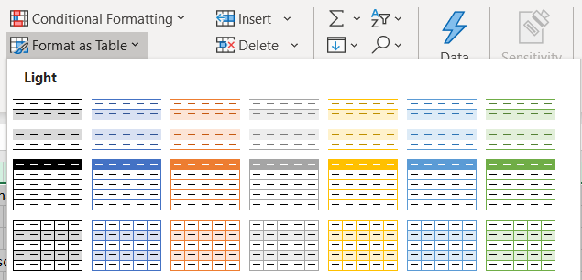
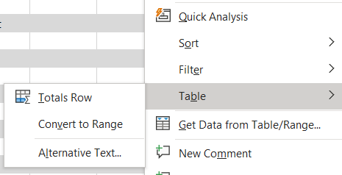
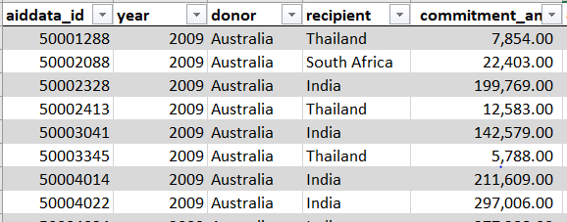
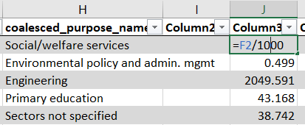
Why use data tables?
1
Ease of formatting
3
Access to functionality
2
Columns are sortable
4
Formulas drag down automatically
Notes:
An Excel spreadsheet is a large flexible grid that is used to store, modify and analyse information.
This data is typically numerical, but can also be things like text, dates, chart objects etc.
In Excel, data is stored in a worksheet, which is made up of rows (1) and columns (2). The intersection of a row and column is called a cell (3), and can contain may types of data.

Slide 4
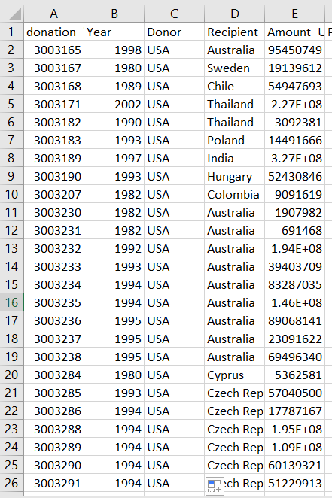
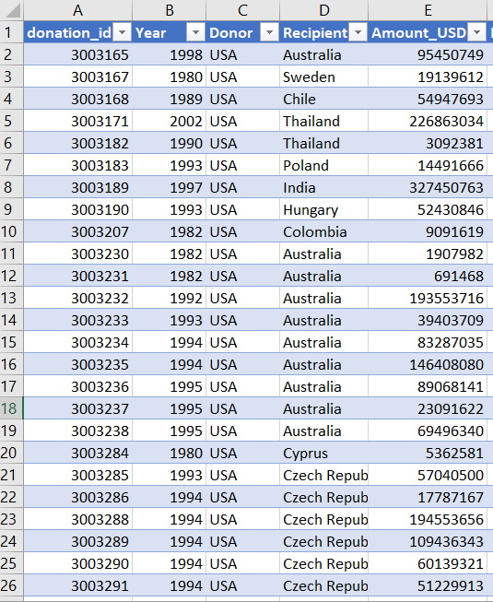
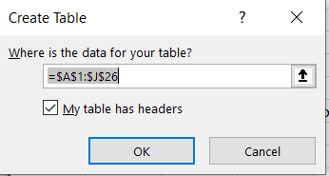
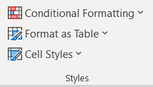
Converting ranges to tables
RANGE
TABLE
1
CTRL + T
2
In the Home tab, select:

Slide 5
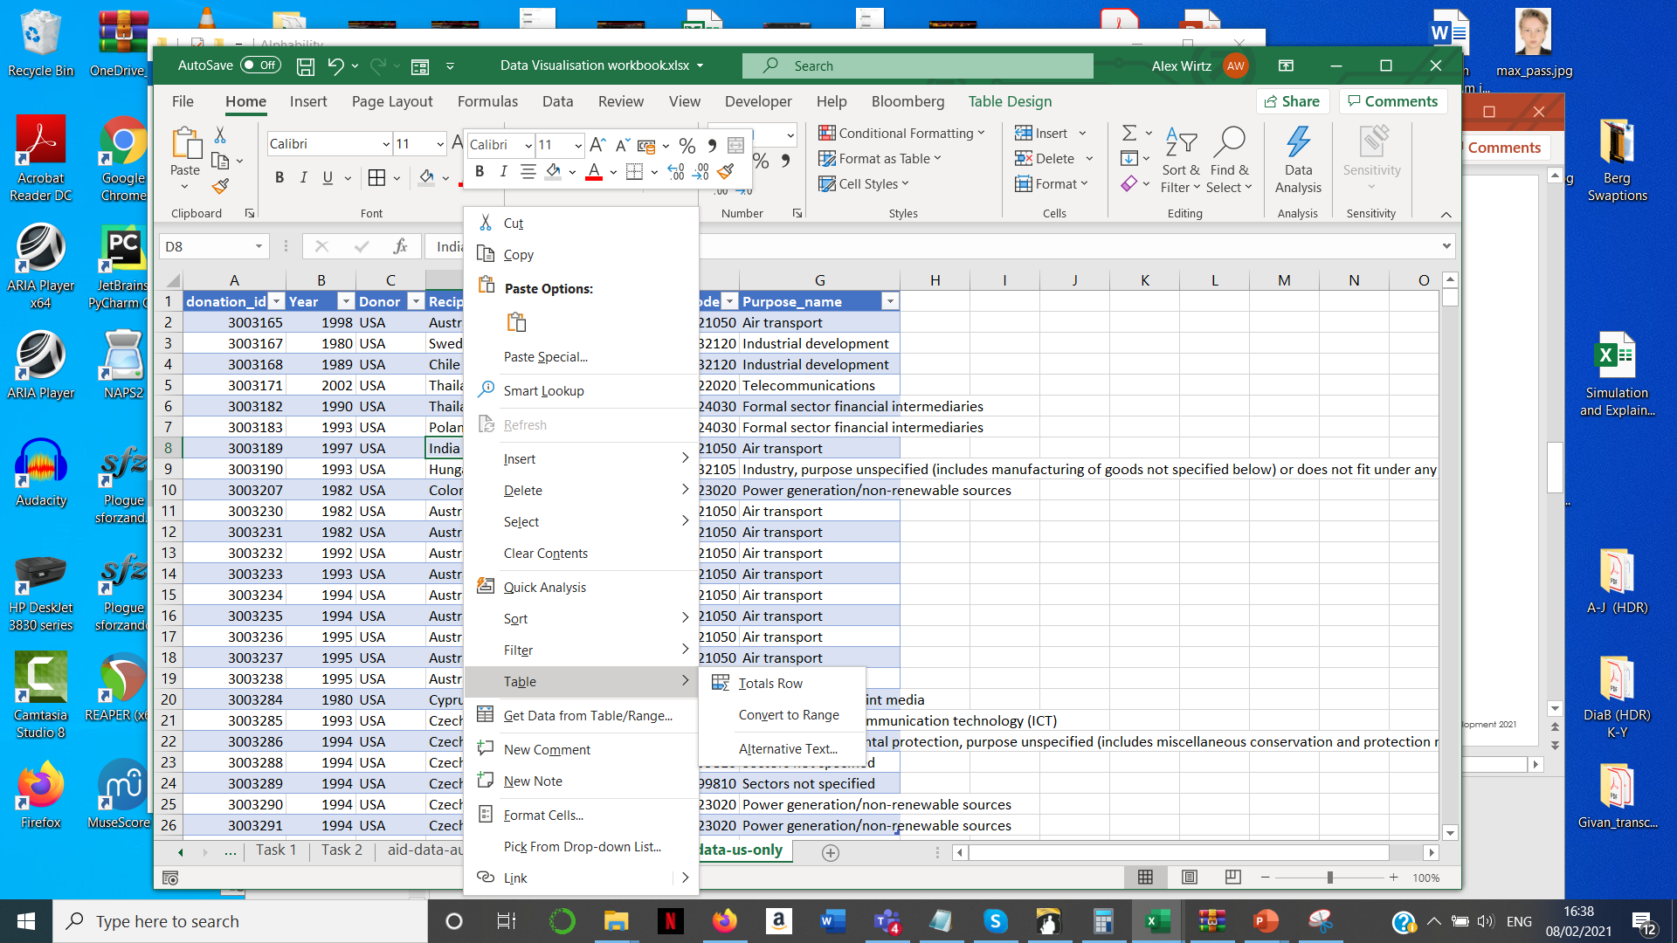
Converting Tables to RANGES
TABLE
RANGE
1
Right-click anywhere in the table, find the Table option and choose Convert to Range.

Slide 6
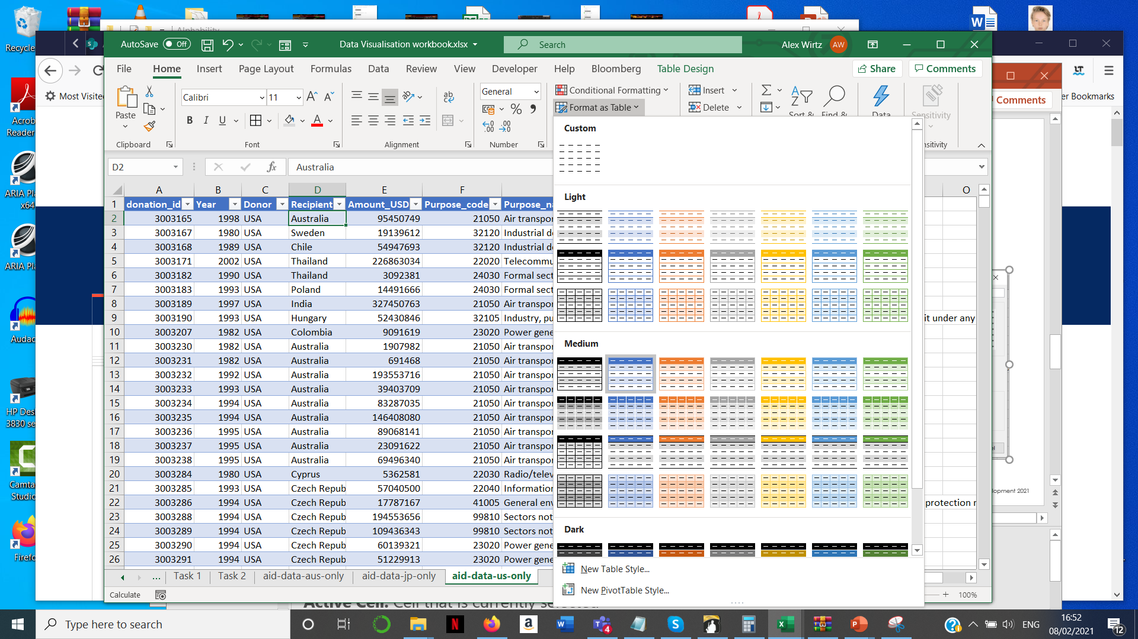
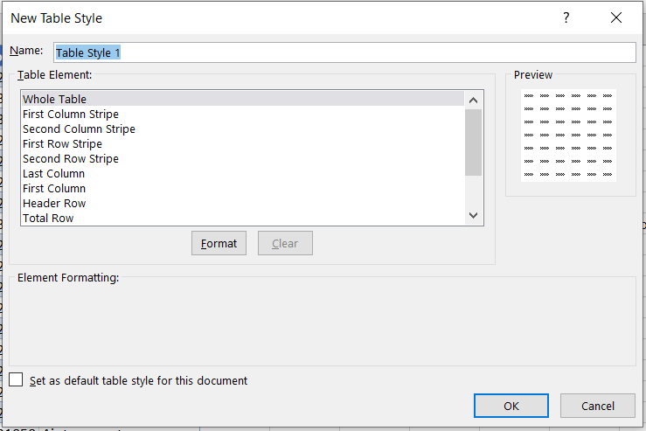
Formatting tables
The defaults should suffice …
… but you can create styles consistent with your firm’s branding if you need to…
Notes:
Column: Vertical series of adjacent cells from top to bottom
Row: Horizontal series of cells from left to right
Cell: Intersection of a row and column
Active Cell: Cell that is currently selected
Cell range: Series or block of adjacent cells
This range here would be indicated as cell E5 to G7. So from the top left hand cell to the bottom righthand cell.

Slide 7
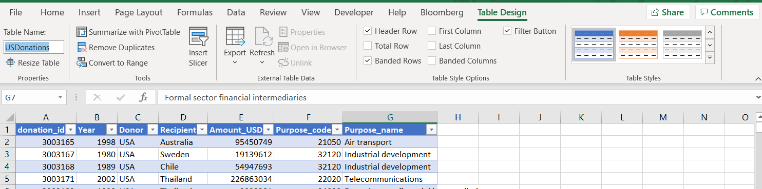
Data Table Naming and referencing
1
Name a table: click on the table to reveal the Table Design tab in the ribbon. The name field can be found to the far left.
2
Referencing: SUM a row or column as follows:
=SUM(table_name[column_name]) =SUM(USDonations[Amount_USD])
Notes:
1: Ribbon Interface
Displays tab commands organized into groups. If you click the different tabs, you will see the commands change. Notice that some of the commands might be grayed out. This is because those commands are only usable in certain situations. The File tab, which opens Backstage view, is also included here.
2: Tabs
Groups of similar commands are organized under tab names. Click a tab to view the commands in the ribbon.
3: Quick Access Toolbar
As the name implies, the Quick Access toolbar gives you quick access to frequently used commands. This toolbar is completely customizable and can be positioned above or below the ribbon commands.
4: Name Box
Every cell has a name in the format “ColumnRow”. The name of the currently selected cell, called the active cell, is shown in the Name Box. In the sample image, the active cell is A1.
5: Formula Bar
The Formula Bar allows you to enter data in a cell. Data can be alphanumeric, pictures, symbols, or (as the name suggests) formulae.
6: Working Area
The data contained in the file will be shown here.
7: Worksheet Tabs
Every Excel file is properly referred to as a workbook. A workbook can contain one or more worksheets, just like an accounting ledger can contain one or more pages. Click these tabs to switch between the different worksheets.
8: Status Bar
This bar is used to display information about the workbook. Any running calculations will be shown here. There are also some zoom and view commands here.
9: Scroll Bars
As you grow more accustomed to working with Excel, you may begin to work on larger files. When all of the information in a worksheet will not fit on the screen, you can use these scroll bars to scroll horizontally or vertically through the data.

